Slide 1
LAb1 - EZgas

Slide 2
Goals of the Lab
Requirement engineering
Analysis
Formalization (context diagram, FR, ..)
Consistency

Slide 3
High level, informal description
EZGas is an application to help drivers find gas at lowest prices.
Gas station owners can register their gas station with prices and eventually discounts. Users look for gas stations closest to them and with best prices and quality of service.

Slide 4
Requirements document
Business model
Stakeholders
Context diagram
Functional requirements
NF requirements
Table of access rights
Use cases / scenarios
Conceptual diagram / Glossary
System design
Deployment diagram

Slide 5
The core information
Gas stations (22000 in italy)
Location
Prices (many types of fuel are sold)
(Quality of service)
(other services offered)

Slide 6
The core functions
Define (write) gas station
Define (write) prices for gas station
Show gas stations in a certain geo area, with prices
Filter cheapest
Filter nearest
Highest quality of service

Slide 7
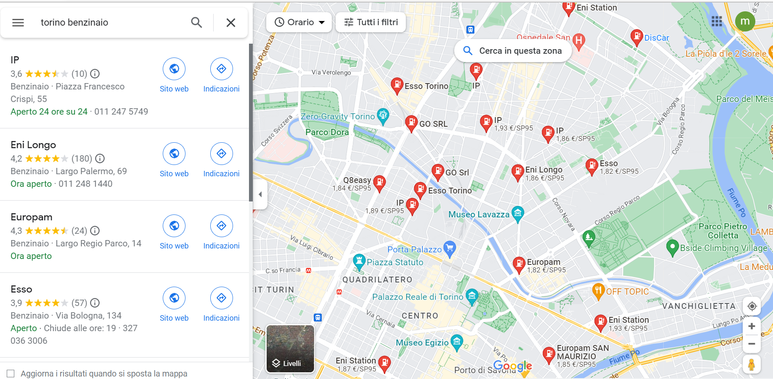
The core function
Car driver
Chatgpt, show me where is the closest cheapest gas station!

Slide 8
The core problem
Who collects and uploads prices?
20.000+ gas stations in Italy
Why should he/she upload prices?
Where the money comes from to sustain the application development and operation?
Not a problem: who reads?
Drivers

Slide 9
The key point: consistency
Many options are possible, all options are equally acceptable
but
given a certain set of decisions, all parts of the document MUST BE CONSISTENT

Slide 10
Business model
Answers those questions
Who? (customer segments)
Why? (value proposition)
Money flow? (revenue stream)

Slide 11
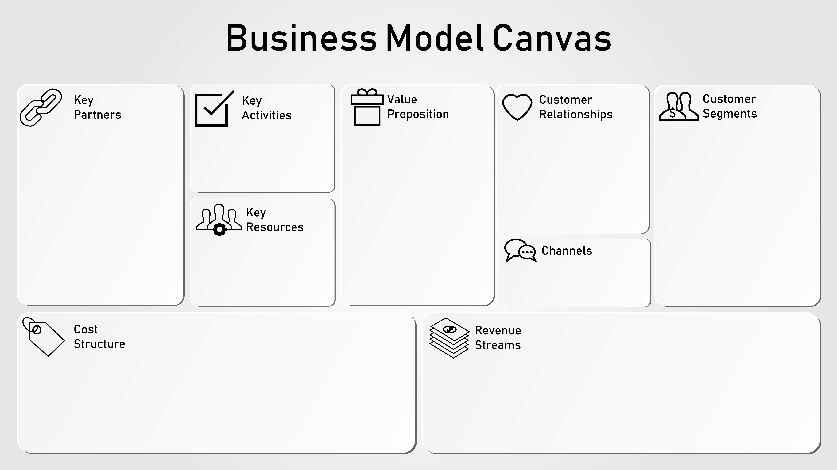
Business model
See Business model canvas

Slide 12
Options
 | Organization pays for (Ministry of transport) | Crowdsourcing + ads or Crowdsourcing + freemium | Automobile club + crowdsourcing | Selling data | Gas station owner advertising
Who uploads prices | Gas station owners (by law) | Drivers (and also gas station owners) | Drivers (and possibly also gas station owners) | Drivers (and also gas station owners) | Gas station owners
Why | Obliged by law | Drivers: know the prices | Drivers: know the prices | Pay the gas station owner for uploading | advertize gas station
Revenue stream | Ministry pays | From ads (google ads or similar) | Club pays | Selling data (gas prices, selling trends, traffic trends..) | Gas station owners pay (to be ranked higher in searches)
Consequences on FR (consistency) |  | Find fake prices uploaded Ad management Payment management | Find fake prices uploaded | Statistic analysis of data | Specific ranking algorithm

Slide 13
Choice
N 2: crowdsourcing + ads, and freemium

Slide 14
Stakeholders
Drivers
Gas station owners (impacted)
Developer team (not an actor)
Developing company CEO (not an actor)
Google ads
Payment service
Administrator (fake data, monitor application for usage, security)
Map service

Slide 15
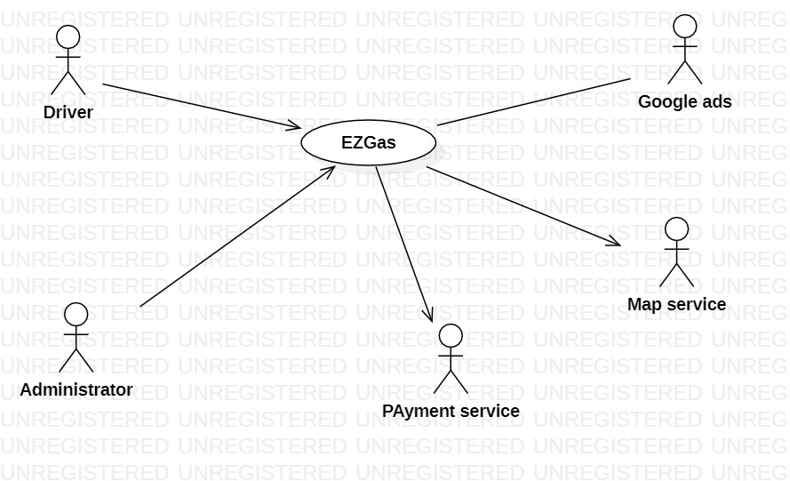
Context diagram

Slide 16
Interfaces
Actors | Physical interface | Logical interface
Driver | Smartphone (when in car) PC (when at home) | App and specific GUI Web browser and specific GUI
Administrator | PC | GUI
Payment service | Internet connection | API specifications https://developer.visa.com/docs
Map service | Internet connection | API specifications
Google ads | Internet | API specifications

Slide 17
FR
FR1 | Authorization and authentication, account management
FR1.1 | Sign up (create account and password)
Fr1.2 | Log in
1.3 | Log out
FRx | Manage account
x.1 | Change password
x.2 | Delete account
 | Upgrade account
FR2 | Monitor usage
2.1 | Block driver from access
2.2 | Count drivers, active drivers, current drivers
2.3 | Log all activity (log in logout, types of accesses) of each user
 | Define subscription plan
 | Select subscription plan for driver (attach subscription plan to driver)

Slide 18
FR
FR3 | Manage gas stations and prices
FR3.1 | CRUD gas station
FR3.2 | CRUD price record of fuels
FR3.3 | Attach / detach price record to gas station
Fr3.4 | Upload price record for gas station
FR3.5 | Compare price record for gas station by different drivers and compute official price record
FR3.6 | Decide price record to be attached to gas station
3.7 | Attach / detach QoS evaluation to gas station
3.8 | Upload QoS review for gas station
3.9 | Compare Qos reviews by different drivers and
3.10 | Decide QoS review to be attached to gas station
3.11 | Recognize fake drivers / fake price lists
3.12 | Compute and show all gas stations with prices given a geo position
3.12.1 | Compute and show gas stations with lowest prices given a geo position
 | Compute price trends per gas station Compute price trends per geo area

Slide 19
FR
FR4 | Manage Ads
4.1 | Request ad to google ads (position, driver profile)
4.2 | Show ad to driver
4.3 | Cancel ad
FR5 | Manage maps
5.1 | Request map tile
5.2 | Show map tile to user
5.3 | Overlay gas stations on map tile
FR6 | Manage payments
6.1 | Send payment request
6.2 | Log payment, change privileges
6.3 | Provide payment info to driver

Slide 20
FR5 | Driver profile management
FR5.1 | CRUD profile
FR5.2 | Attach profile to driver
FR5.3 | Get driver position

Slide 21
Table of rights
 | Administrator | Driver | Google ads | Map service | Payment service
FR1 | Y | Y | N | N | N
FR2 | Y | N | N | N | N
FR3
FR4
FR5
FR6

Slide 22
NFR
NFR | measure
Usability | time to enter in application and find lower price gas station in an area (for the first time a new user uses the app ) < 10 min for user who is smartphone user since > 1yr (NOTE above is a use case)
 | time to download and deploy < 10 min
 | user satisfaction survey: average grade > 4 (scale 1 to 5) with at least 100 respondents
Efficiency | size of app to download < 100Mbytes
 | Response time for all functions (except the following) < 0,5 sec
 | Login < 1min
 | Fr 6 < 1 min
Reliability | Defect = non correct price is reported, < 1 per user per year Defect = no response, unexpected shutdown, freeze < 3 per user per year Availability of server: 99.999% on one year (0.3 days downtime)
Portability | Client app should be available on IOS (from version 16 up) and android (from version x) Web app should be avaliable on browser , chrome from 121 Edge from ..
maintainability | Adaptation of web app to chrome for android should take less than 1 person month
security | User(driver) data privacy: data about drivers should not be accessible except to driver herself (even not administrator) fr3.6, 3.7 3.8, 3.10 should not be used by malicious user

Slide 23
Glossary
Driver = person who drives a vehicle and is intereted in prices of fuel
position
Gas station = business that sells fuels
position
Price, price list
Map, map tile
Review
Payment
Fuel

Slide 24
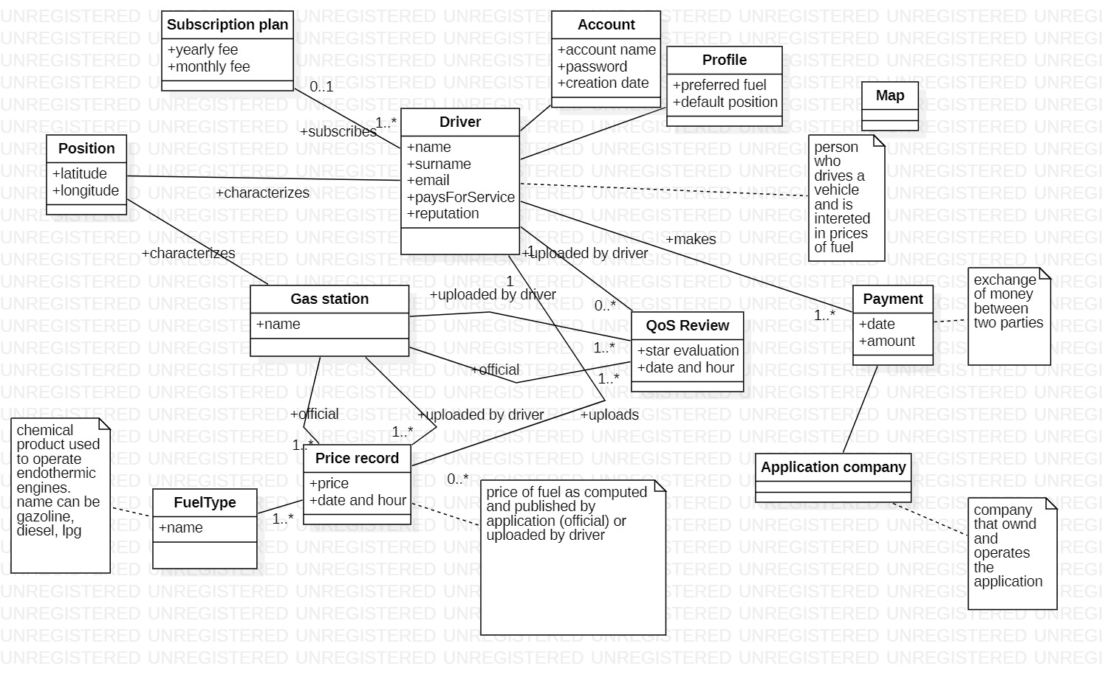
Glossary

Slide 25
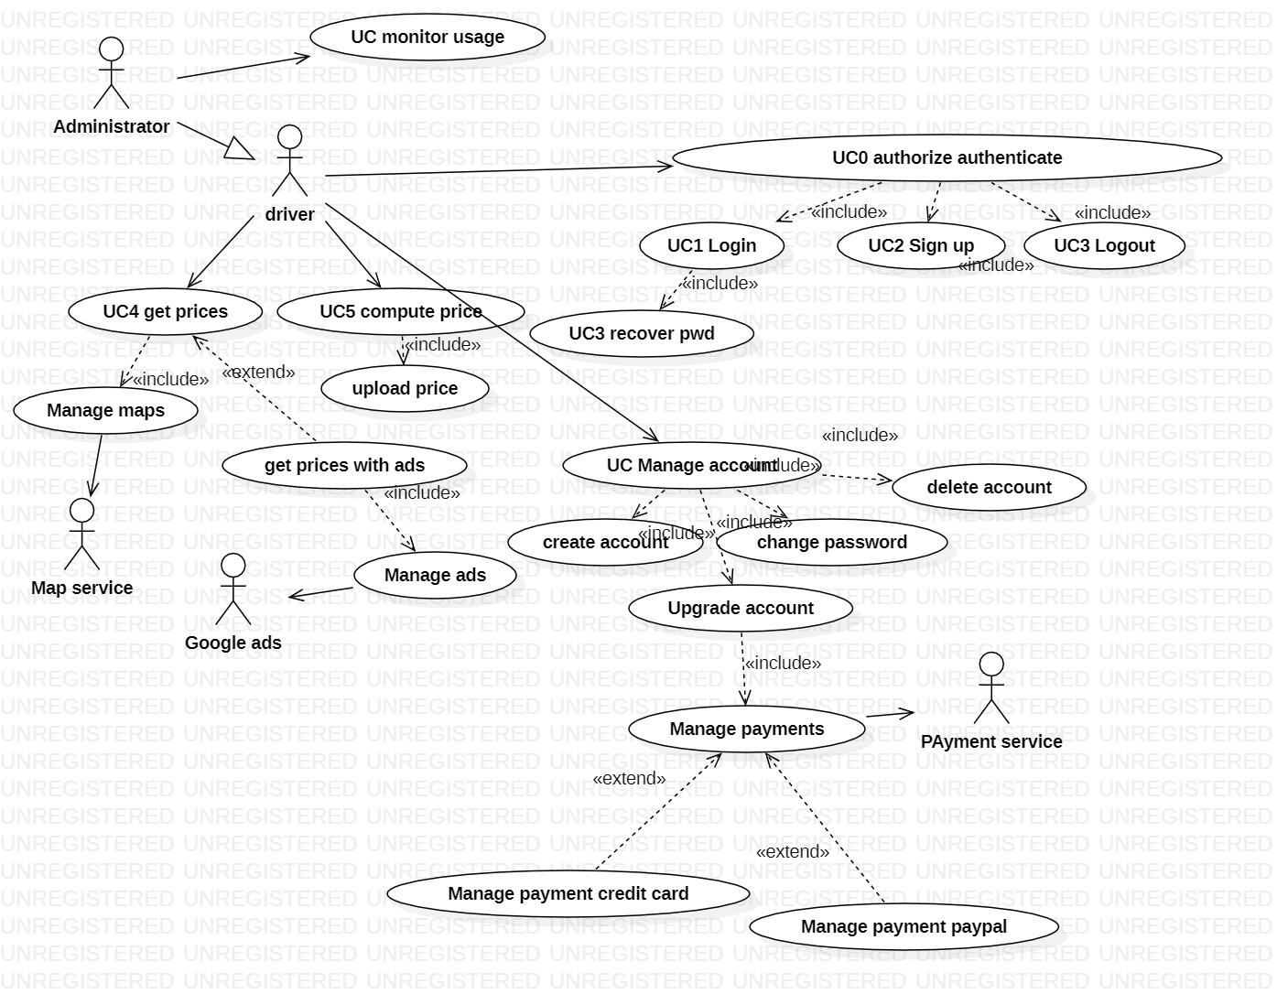
Use cases and scenarios

Slide 26
UC1: Login
Made of scenarios
S1, s1-exc1, s1-exc2

Slide 27
UC1 Login - Scenarios
Scenario S1 (nominal)
Precondition: driver has account
Postcondition: driver authenticated
Step | actor | system | Fr1.1
1 | Driver Asks to use application
2 |  | Asks if driver has account
3 | Yes
4 |  | Ask account name and pwd
5 | Enter account name and pwd
6 |  | Check accountname and pwd. Ok Notify success

Slide 28
UC1 made of scenarios
Scenario s1-exc1
Wrong accountname
Scenario s1-exc2
Wrong pwd
Scenario s1-exc3
Forgot pwd, recover pwd procedure

Slide 29
UC2: sign up
Made of scenarios
S2, s2-exc1, s2-exc2

Slide 30
UC2 signup - Scenarios
Scenario S2
Precondition: driver has no account
Postcondition: driver has account
Step | actor | system
1 | Driver Asks to use application
2 |  | Asks if driver has account
3 | no
4 |  | Ask to define accountnamr
5 | Enter account name
6 |  | Check accountname already taken. Ok. Ask pwd. Tell rules on pwd
7 | Enter pwd
8 |  | Check pwd. Ok
9 |  | Create account

Slide 31
UC2 scenarios
Scenario S2-exc1
Accountname taken
Scenario s2-exc2
Password wrong (not satisfyng password rules)

Slide 32
UC3 recover pwd
Precondition: user has account and pwd
Scenario S3
Precondition: user has account and pwd
Steps: ask to user email, check if corresponds to the one declared, send there one time link to reset pwd
Postcondition: password changed
Scenario S3-exc1
Email attached to user not valid
Postcondition: password not changed
Scenario S3-exc2
User does not answer to email to confirm identity
Postcondition: password not changed

Slide 33
UC4 Get prices
Actor: driver
Goal: know prices of fuel in a certain area
Short description: given the position of the driver, retrieve and show the prices of fuel in a certain area around the driver
Scenarios
S4.1, nominal. Position is retrieved, area is computed, gas stations in area retrieved, prices of all fuels retrieved, all prices shown (no ads shown)
S4.2, variant1 with ads
S4.3, variant2, only prices relevanto to driver profile are shown
S4-exc1. position not found, gps off
S4-exc2. position not found, gps not working
S4-exc3. one gas station price is unavailable
S4-exc4. all prices for all gas stations are unavailable
S4-exc5. no gas stations in the area

Slide 34
Scenario S4.1
Precondition: driver has account, driver is authenticated, driver’s position is known
postcondition : prices for gas stations are shown
Step | actor | system | FR
1 | Driver Asks prices
2 |  | Retrieve position of driver | Fr5.3
3 |  | Compute rectangular area of edge (1km?) centered on position of driver | FR?
4 |  | Retrieve gas stations in area | FR3.12
 |  | Show gas stations and prices | FR3.12

Slide 35
UC 5 Compute price
Actor: driver
Goal: estimate prices for certain gas station
Short description: given the price uploaded by one or more drivers, estimate the official price for a fuel in a gas station
Scenarios
S5.0: no uploads. Associate last price of previous day
S5.1: first upload in the morning. Change price if driver has high reputation
S5.2: after first upload. Verify if same price. If yes, no change, increase reputation of last driver who uploaded the price. If no, decrease reputation of last driver who uploaded the price.
S5-exc1. gas station does not exist
S5-exc2. fuel price negative, or out of highest range

Slide 36
Start with easy use case
Log in / sign up
Start with most important scenarios (and use cases)
Ex user gets info about closest gas station with lower price
Identify Use cases
For each use case
Nominal scenario (define scenario)
Exceptional scenarios (at least name them)

Slide 37
System design
EZGas is composed of
(no hardware components)
EZGas web application (artifact)
IoS App (artifact in deployment diagram)
Android App (artifact in deployment diagram)

Slide 38
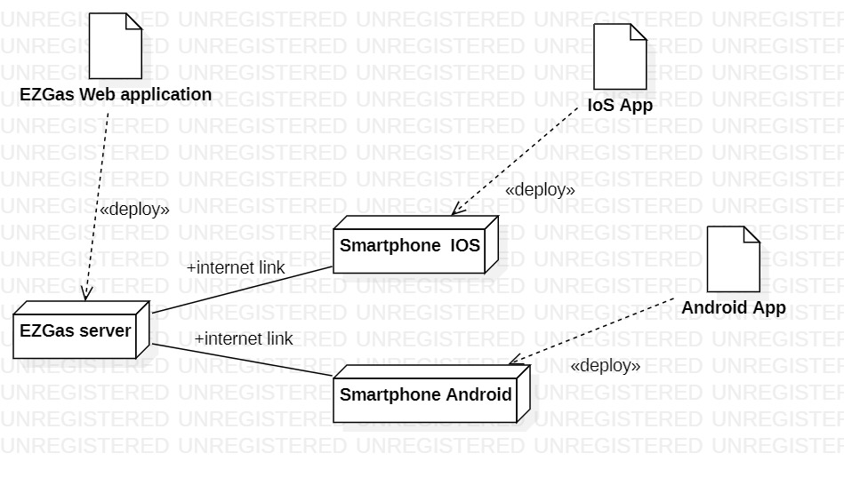
UML deployment diagram

